Slide 1

My Visit to the Optometrist
by Karen Glanz

Slide 2

This is where I will have my eye test.

Slide 3
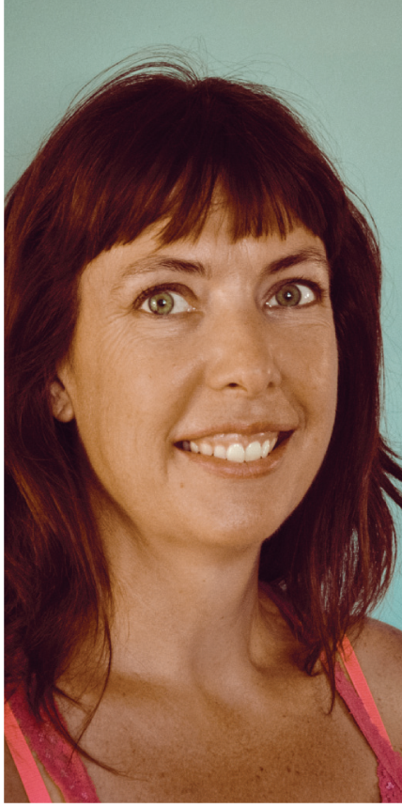
This is Karen. She will test my eyes.

Slide 4
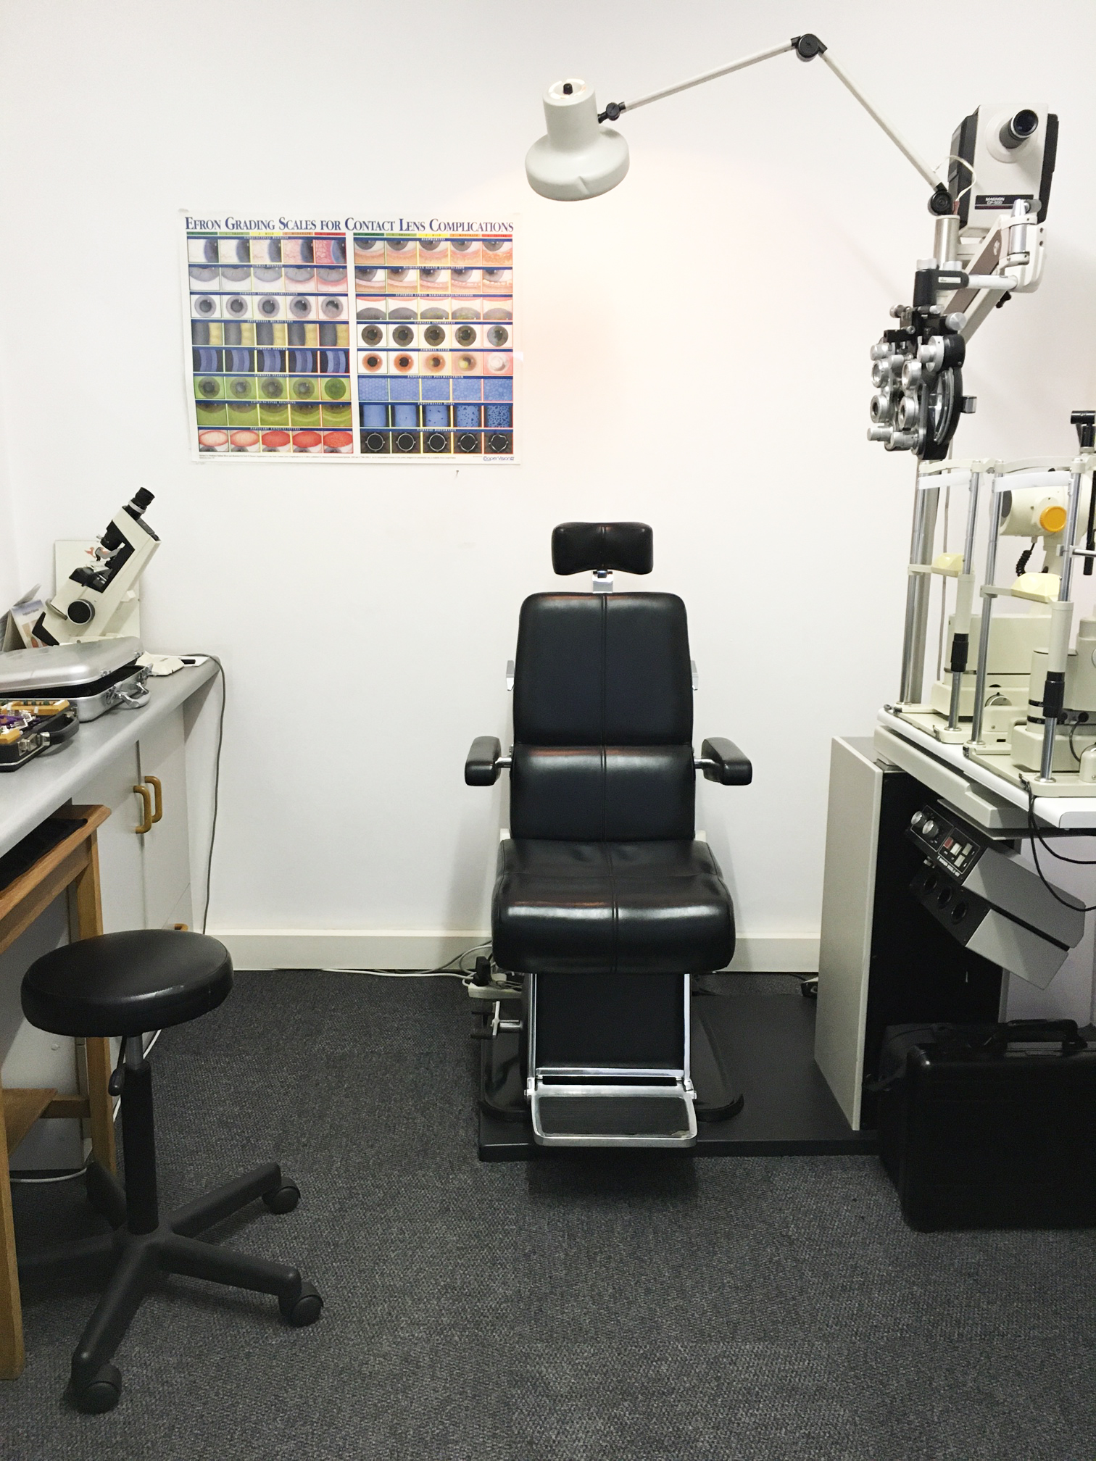
Karen will check my eyes in the testing room.

Slide 5
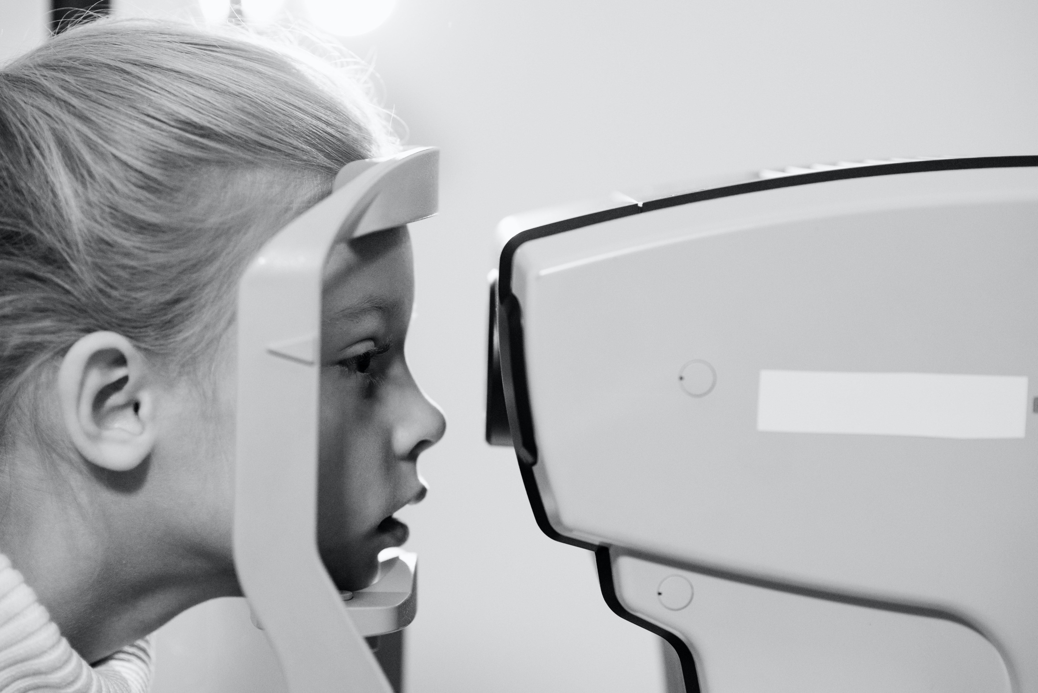
I’m going to look at a picture inside a special machine.

Slide 6
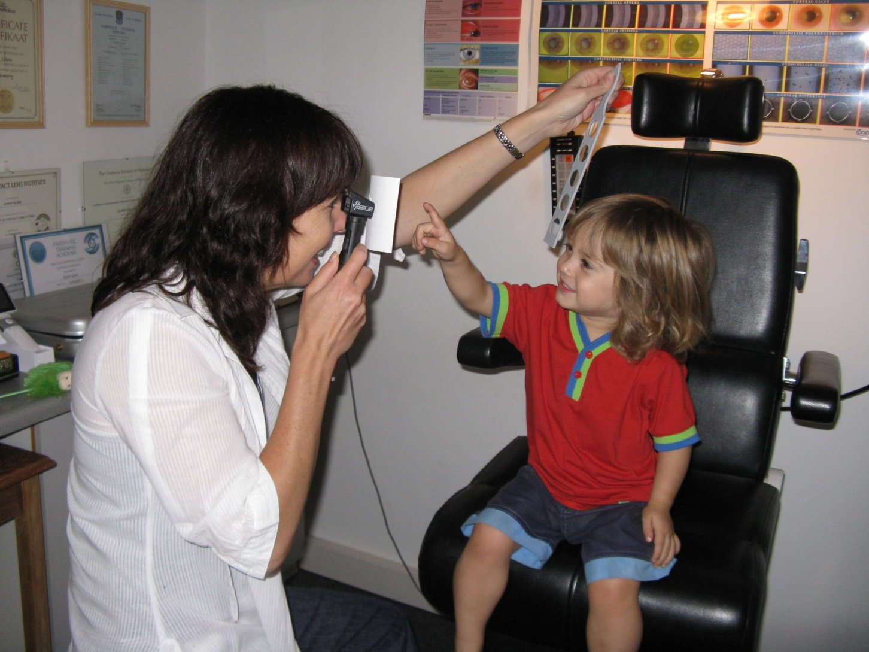
I will sit in a black chair while Karen shines a bright light in my eyes.

Slide 7
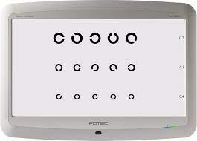
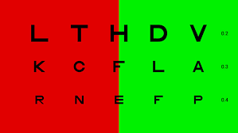
To check how strong my eyes are, I will also look at shapes and letters on the wall.

Slide 8
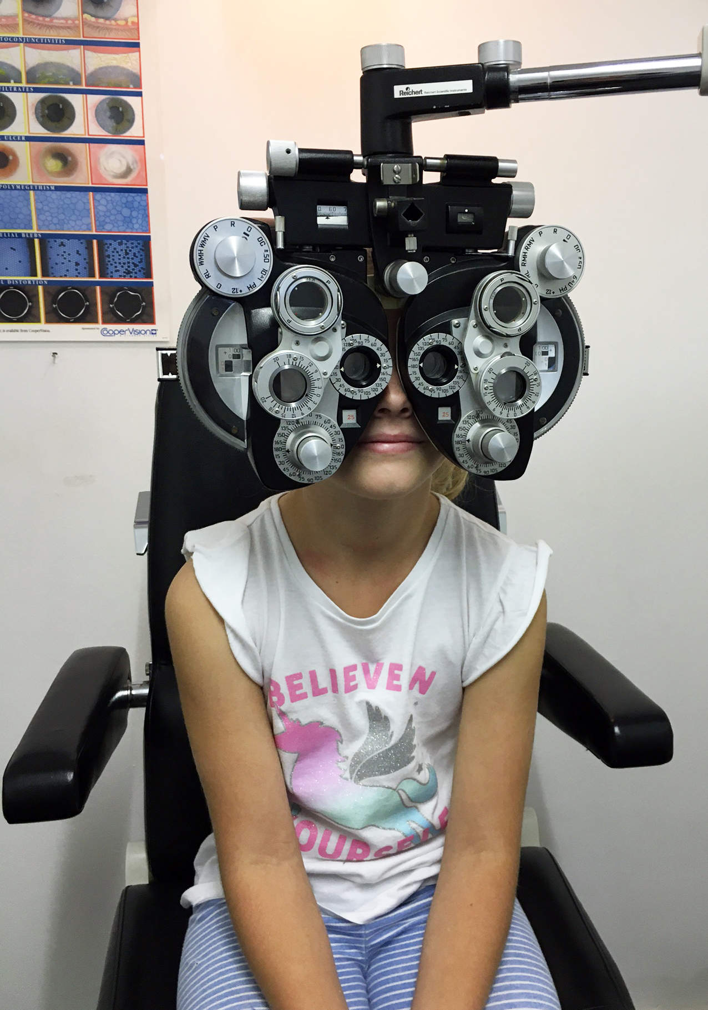
I will also look through some special lenses…

Slide 9
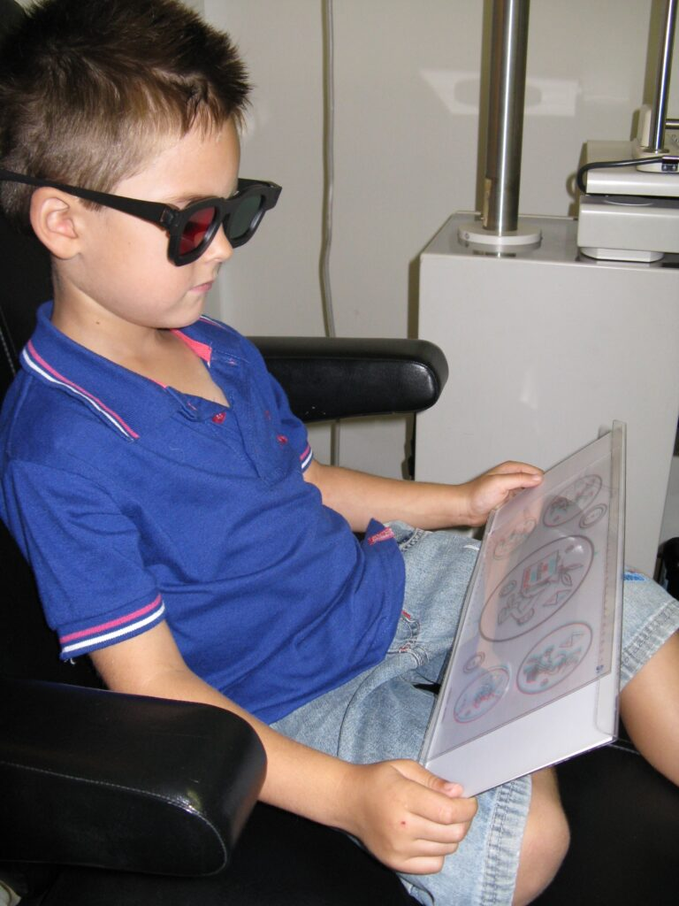
And put on some funny glasses!

Slide 10
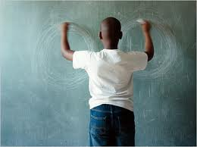
I might even draw circles on the board …

Slide 11
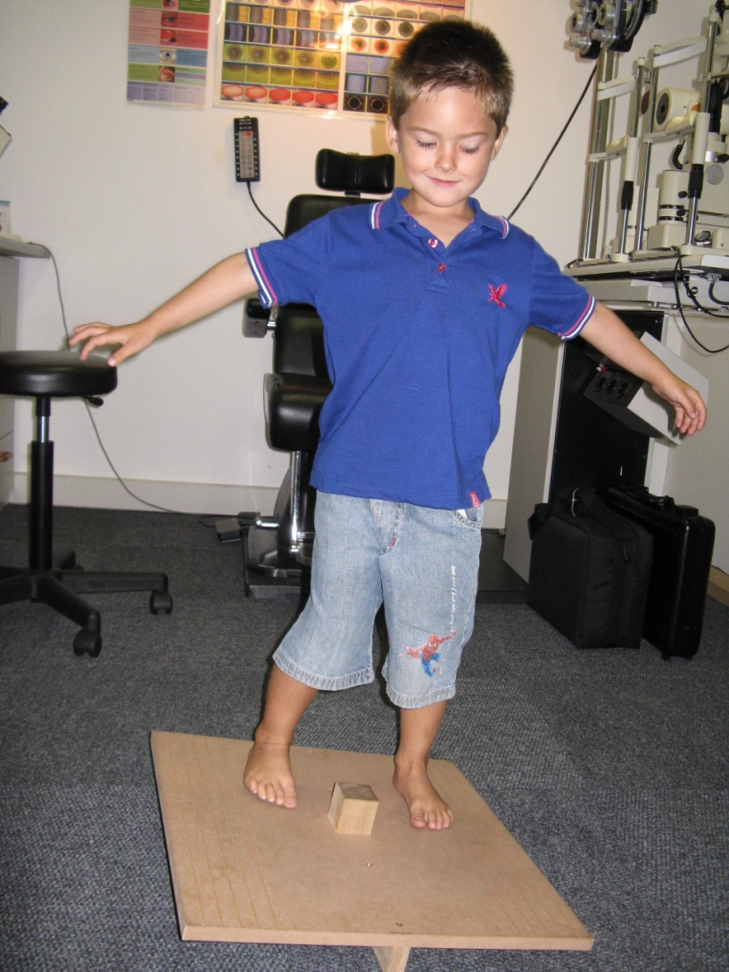
and balance on a board!

Slide 12
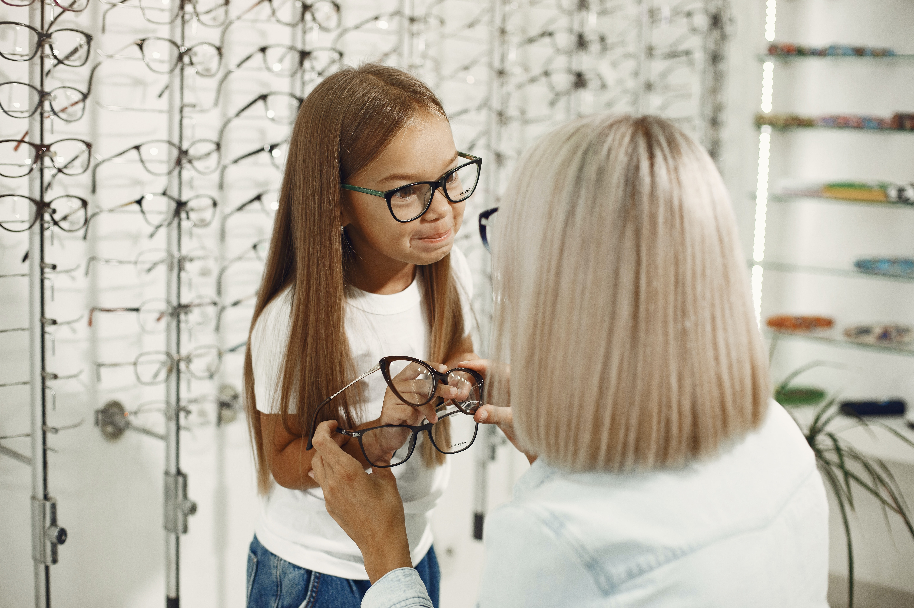
After the test is finished, Karen will let me know if I need glasses.

Slide 13
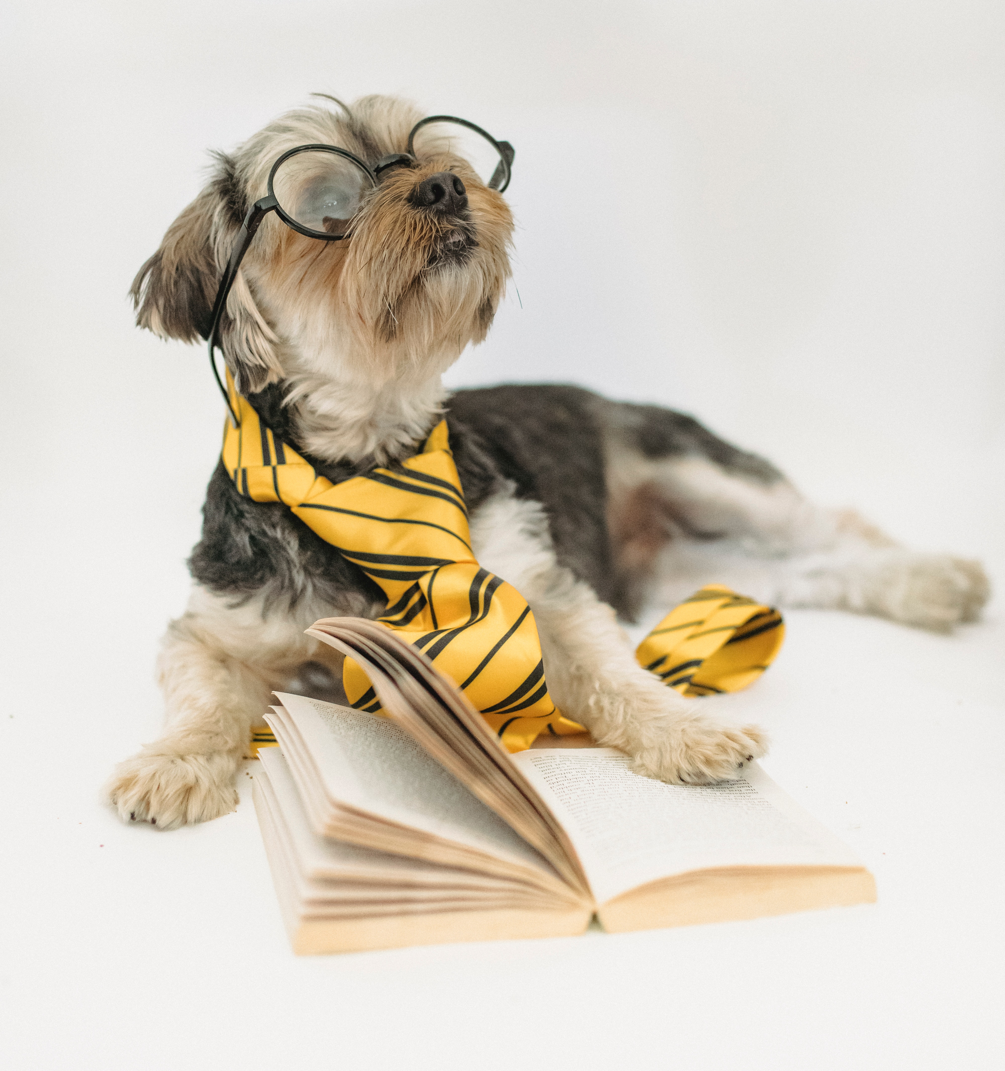
Now just for fun, even dogs can wear glasses!
The End.

